Slide 1
From Paper to Skyline: Insights From San Francisco Building Permits
Presented by: Aaya Ali
DAB-14

Slide 2
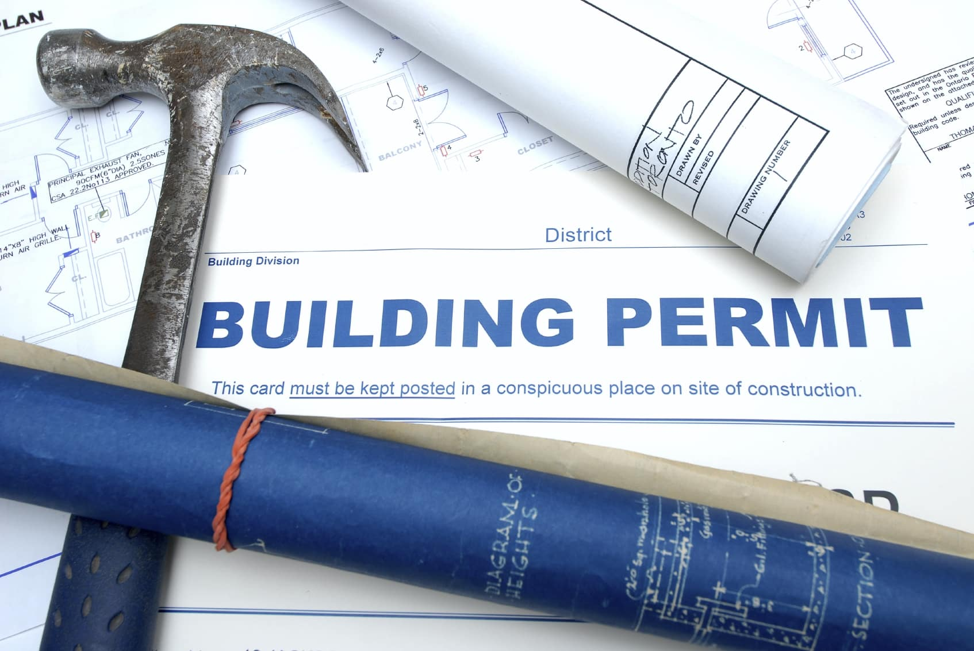
Problem Statement
Getting construction permits in San Francisco is often slow, unpredictable, and unclear.
02
For example, the 33 Tehama Street building faced long permit delays after a water leak, leaving the building empty, work stopped, and millions lost.
03
For example, the 33 Tehama Street building faced long permit delays after a water leak, leaving the building empty, work stopped, and millions lost.
04
Identify the Factors That Affect The Approval of The Permits, to support better decision maker to improve permits system.

Slide 3

01
Getting construction permits in San Francisco is often slow, unpredictable, and unclear.
Real Life Example
For example, the 33 Tehama Street building faced long permit delays after a water leak, leaving the building empty, work stopped, and millions lost.
03
For example, the 33 Tehama Street building faced long permit delays after a water leak, leaving the building empty, work stopped, and millions lost.
04
Identify the Factors That Affect The Approval of The Permits, to support better decision maker to improve permits system.

Slide 4

01
Getting construction permits in San Francisco is often slow, unpredictable, and unclear.
02
For example, the 33 Tehama Street building faced long permit delays after a water leak, leaving the building empty, work stopped, and millions lost.
Audience
Government officials & city planners
Construction companies
04
Identify the Factors That Affect The Approval of The Permits, to support better decision maker to improve permits system.

Slide 5

01
Getting construction permits in San Francisco is often slow, unpredictable, and unclear.
02
For example, the 33 Tehama Street building faced long permit delays after a water leak, leaving the building empty, work stopped, and millions lost.
03
For example, the 33 Tehama Street building faced long permit delays after a water leak, leaving the building empty, work stopped, and millions lost.
Main Objective
Identify the Factors That Affect The Approval of The Permits, to support better decision maker to improve permits system.

Slide 6
Objectives

Slide 7

01
Identify the most and least common permit types in San Francisco and their locations.
06
Identify the top 10 neighborhoods by proposed units.
02
Analyze the average approval time for each permit type in San Francisco.
Identify the most common building floors in San Francisco permit applications.
03
04
Analyze yearly trends in permit applications.
05
Analyze permit types by Actual cost.

Slide 8
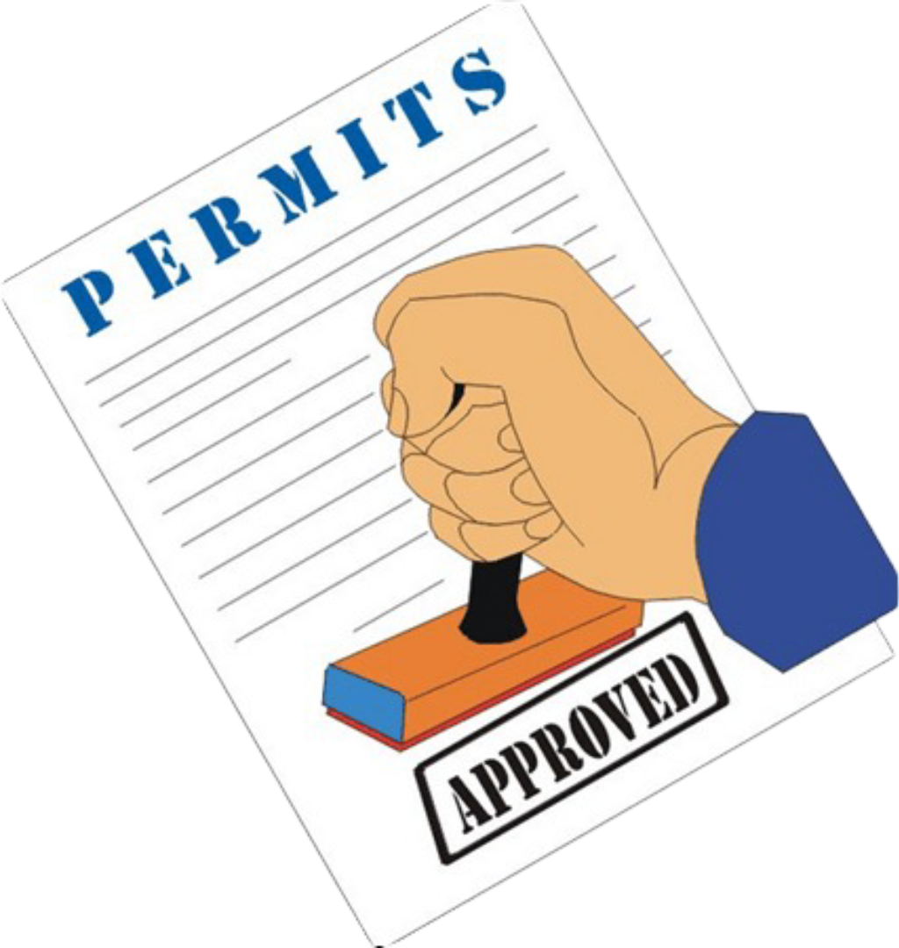


Data Source
Period
Total Number of Permits
Permit Types
184 K
8
San Francisco Open Data Portal
2013-2017
Data Overview
Number of Neighborhood
42

Slide 9
Data Source
Period
Total Number of Permits
Permit Types
184 K
8
San Francisco Open Data Portal
2013-2017
Data Overview
Number of Neighborhood
42

Slide 10
OTC Alterations Permit: Minor alterations or repairs processed quickly.
Demolitions: Permits for demolition of existing structures.
Additions Alterations or Repairs: Permits for
additions, or repairs.
Wall or Painted Sign: Permits for wall signs or painted signs.
Permit Types
Sign - Erect: Permits for installation or erection of signs.
New Construction: Permits for entirely new construction projects.
New Construction Wood Frame: Permits for new buildings with wood frame structure.
Grade/Quarry/Fill/Excavate: Permits for grading, quarrying, filling, or excavating.
OTC: Over The Counter Permit

Slide 11
The Analysis

Slide 12
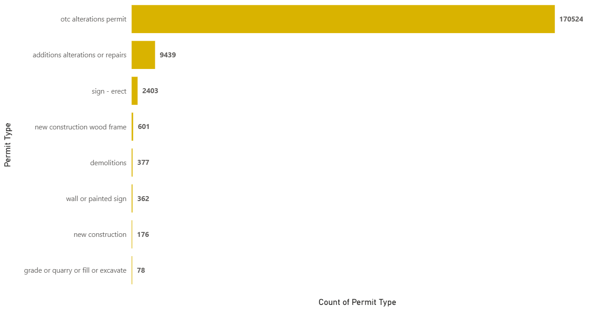

Most Common Permit Types in San Francisco
The most common permit is OTC Alterations with 170K
The least permit is fill & excavate with 78
OTC: Over The Counter Permit

Slide 13
Location of Permits

Slide 14
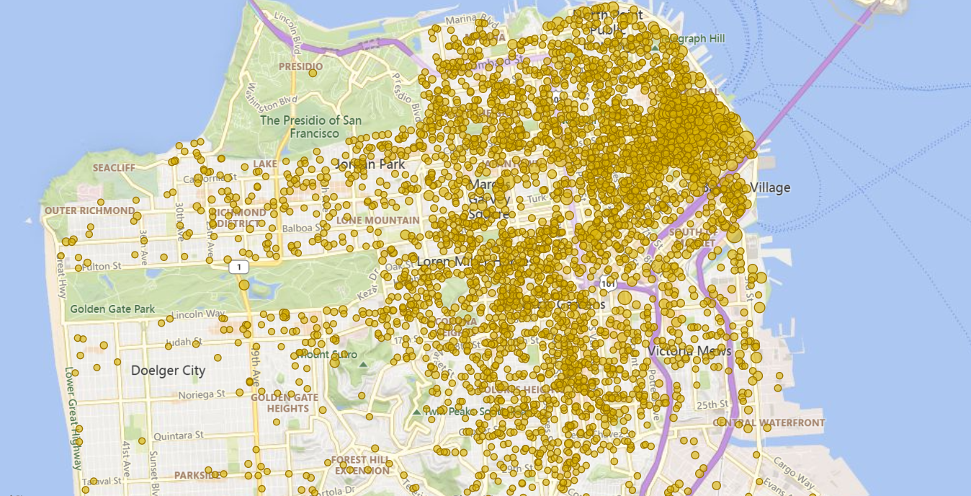
OTC Alteration Permit Location

Slide 15
South of San Francisco Less Permits

Slide 16
North of San Francisco More Permits

Slide 17
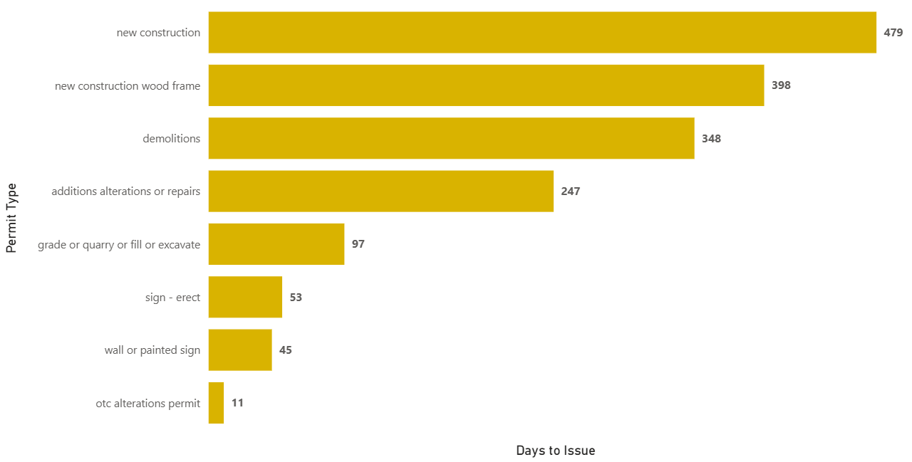
Approval Time by Permit Type
The slowest permit type is New Construction with 479 Days
OTC: Over The Counter Permit

Slide 18

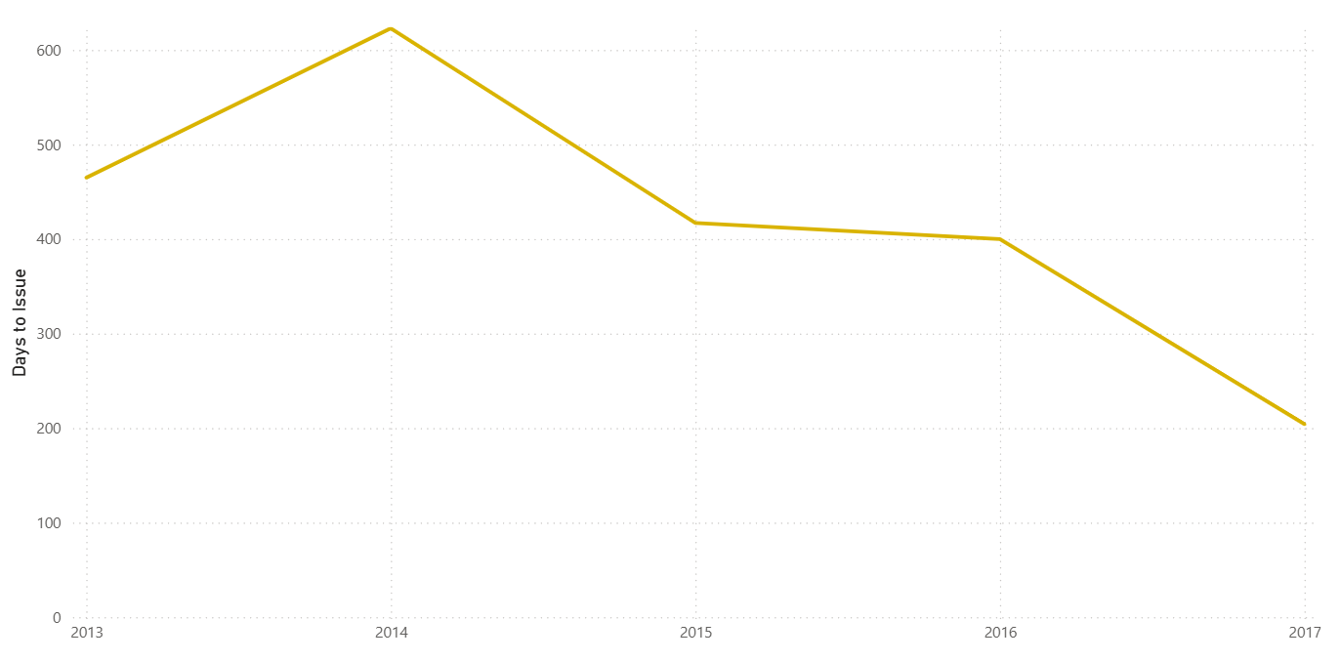

New Construction Permit Over Time

Slide 19
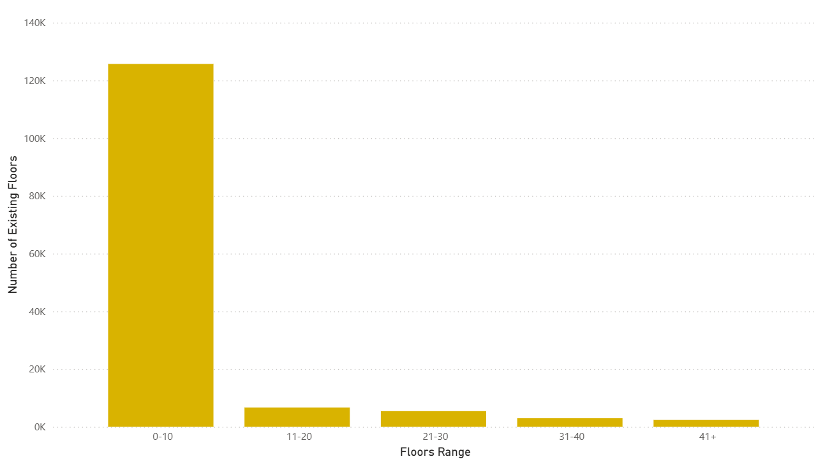
The Rise of San Francisco: Floors by the Numbers
The most common floors range applied for permits is 1-10 floors, with frequency more than 120K

Slide 20
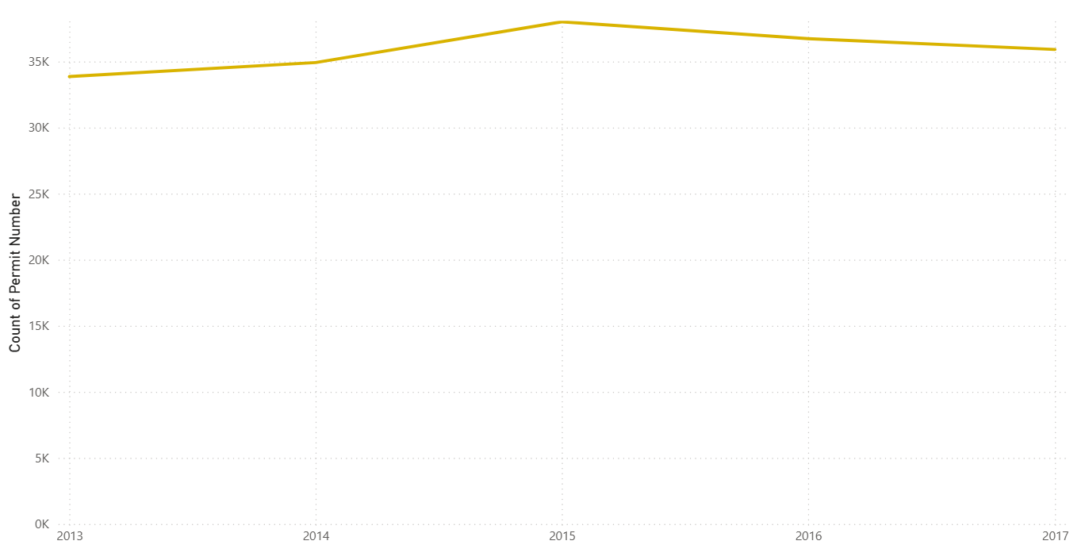
Trends in Permit Applications Over Time
The highest number of permits was in 2015
The lowest number of permits was in 2013

Slide 21
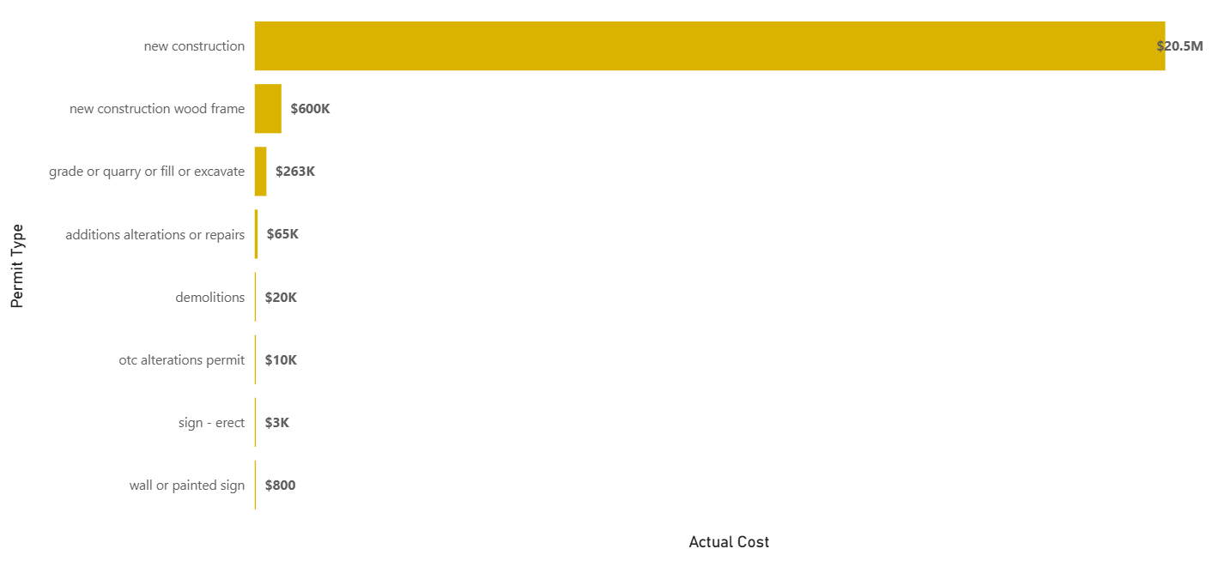
How Much Does It Cost to Build in San Francisco?
New construction permits have the highest costs, while sign installations and repairs are much lower

Slide 22
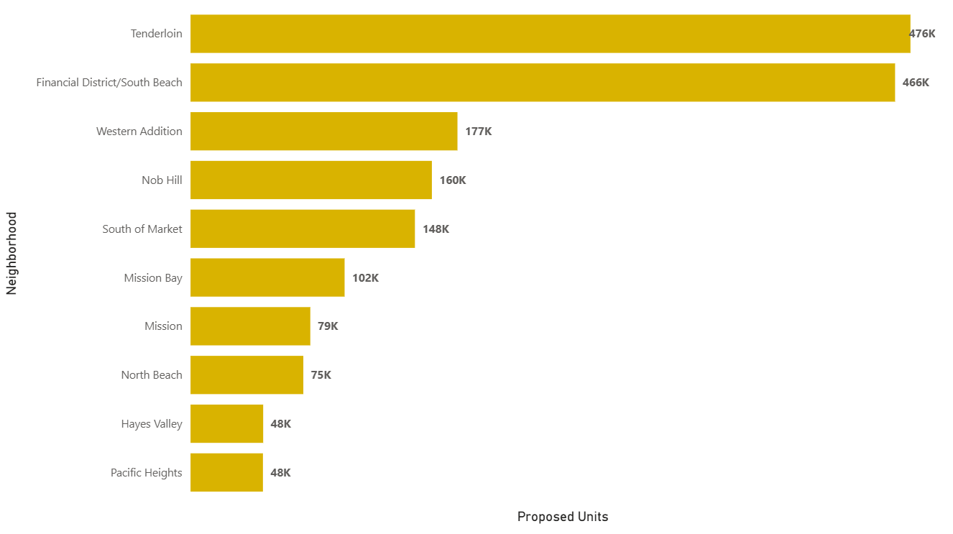

Where San Francisco Is Growing: Top 10 Neighborhoods by New Units
Tenderloin Neighborhood Take 476K Units
Hayes Valley & Pacific Heights Take 48K Units

Slide 23
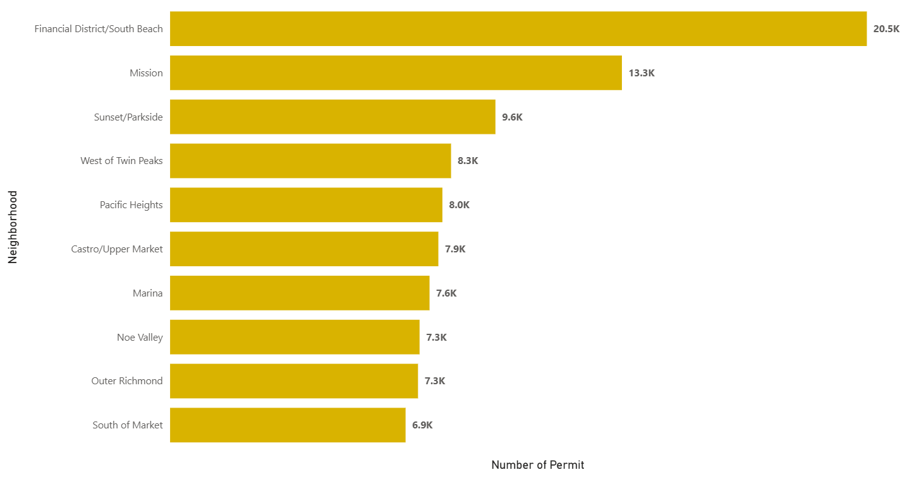
Neighborhoods with the Most Building Permits
Financial District Neighborhood Take 20.5K Permits
South of Market
Take 6.9K Permits

Slide 24
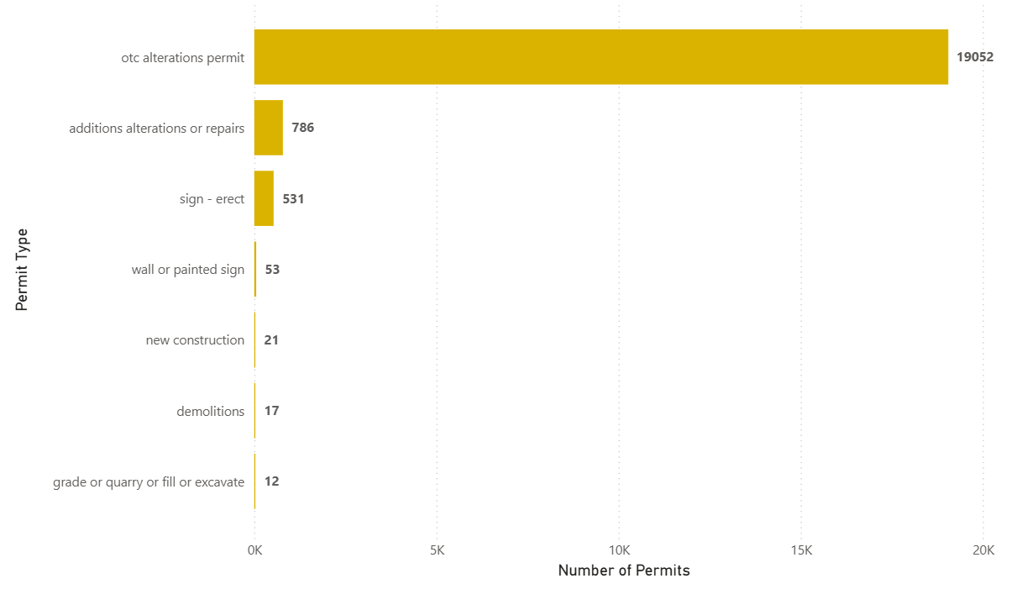
Most Common Permit Types in Financial District
OTC: Over The Counter Permit

Slide 25
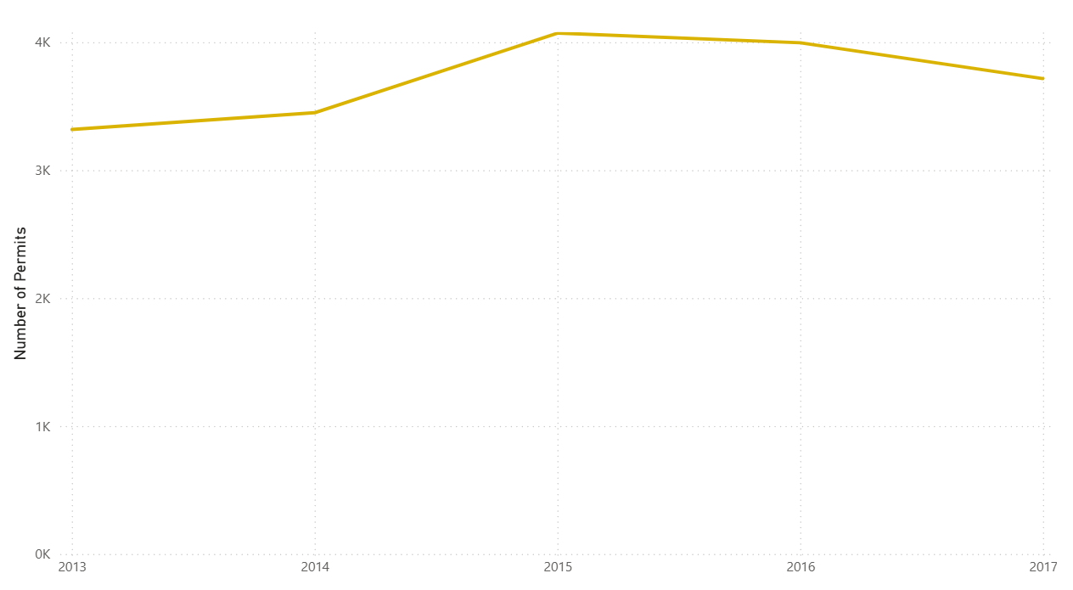
Yearly Trend of OTC Permit in Financial District
The highest number of permits was in 2015
The lowest number of permits was in 2013

Slide 26
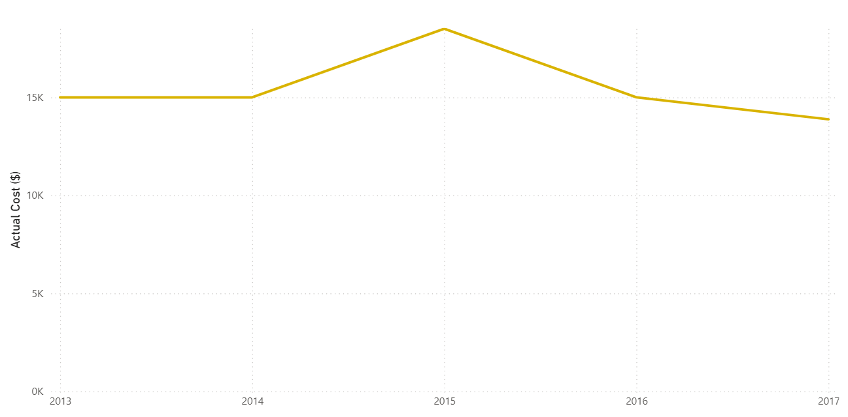

Actual Cost Trend for OTC Permit in Financial District
The highest cost was in 2015
The lowest cost was in 2017

Slide 27
Conclusion
01
02
03
04
Cost
Delay
Neighborhood
Trends
Smaller, lower-cost permits are processed faster.
Most construction is focused in a few active neighborhoods
New construction and complex permits cause the longest delays.
Permit approval times vary year to year, likely due to administrative or economic factors.

Slide 28
Recommendations
01
02
03
04
Resource prioritization allocate more staff to review complex or high-cost projects faster.
Transparency
make approval timelines and requirements clearer to reduce confusion.
Periodic audits
review slow permit categories annually to identify bottlenecks
Neighborhood monitoring
track trends in high activity areas to guide urban planning.

Slide 29
THANK YOU
DO YOU HAVE ANY QUESTIONS?

